Slide 1
Series 21
Proximity Beacon™

Slide 2
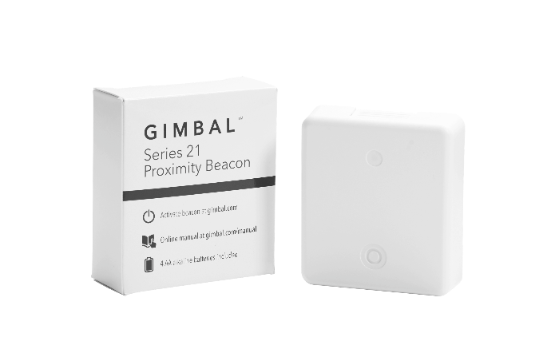
Introducing the Series 21 Proximity Beacon
The new Gimbal Series 21 proximity beacon is:
30% smaller*
50% longer battery life* (up to 18 months)
developed to reduce installation time by 1/3*
extremely low-maintenance
water resistance for safe outdoor use
competitively priced for large-scale, enterprise deployments
delivered with four (4) AA batteries pre-loaded, an on/off switch
features bi-color LED lights to easily determine the beacons functionality
*compared to the previous Series 20 model

Slide 3
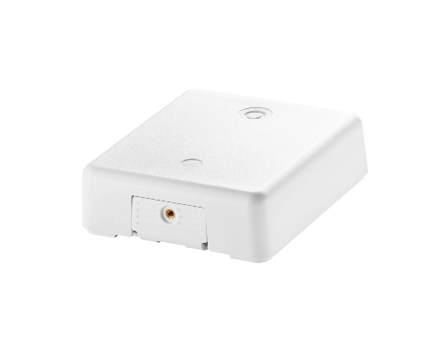
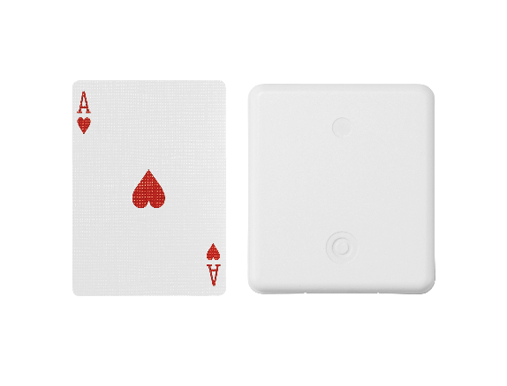
Series 21 Pricing and Availability
Pricing:
1- 9,999 S21 Beacons - $30/ea. + shipping & handling
10,000+ S21 Beacons - $25/ea. + shipping & handling
Color:
White
Availability:
Available in volume early January 2015
FCC Certified in the US; other countries pending

